Slide 1
Reflection

Slide 2
By the end of this Smart Lesson, you should be able to:
State the Law of Reflection.
Explain how images form on plane mirrors.
Calculate the angle of incidence and angle of reflection.

Slide 3
We use rays to represent light as it travels in a straight line.
However there are two types of rays involved in reflection; these are called incident rays and reflected rays.
We call any reflective surface a mirror.

Slide 4
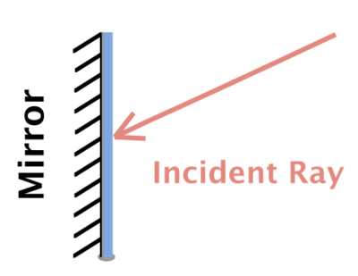
An incident ray is a light ray that travels towards a mirror.
In diagrams, it is represented by an arrow that points towards the mirror.
A mirror is shown on the left of the diagram below - this is how we draw mirrors in our diagrams.

Slide 5
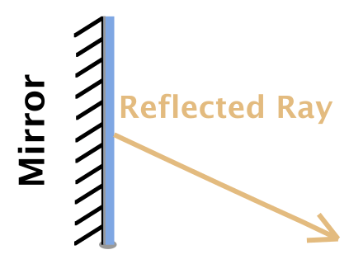
A reflected ray is a ray that has been reflected from a mirror.
It is represented by an arrow that points away from the mirror.

Slide 6
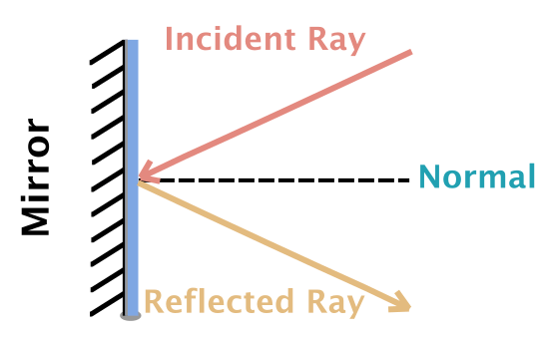
There is another important line called the normal.
This is a line drawn along the point at which the incident ray hits the mirror and reflects away. It is usually used to help draw a reflection diagram.
The normal is always at a right angle (90∘) to the surface of the mirror.

Slide 7
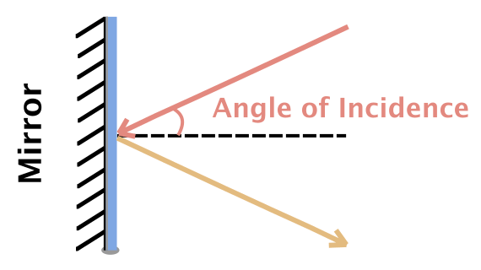
The angle of incidence is the angle between the incident ray and the normal.

Slide 8
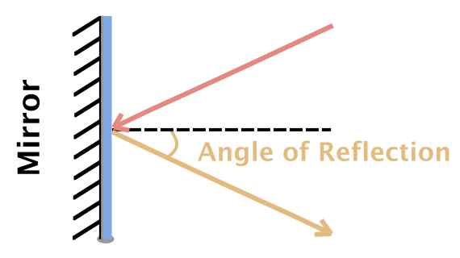
The angle of reflection is the angle between the reflected ray and the normal.

Slide 9
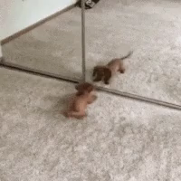

The Law of Reflection states that the angle of reflection is equal to the angle of incidence.
This means that a light ray reflects off a mirror at the same angle that it hits the mirror at.

Slide 10


Slide 11

A plane mirror is a fancy term for a flat mirror.
There are lots of plane mirrors around. You probably have one in your bathroom!
In this section, we are going to learn how images form in plane mirrors.

Slide 12
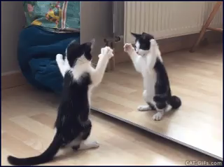
We can see objects because light bounces off them and hits our eyes.
With a plane mirror, the light has left an object, reflected from the mirror, and hit our eyes.
But we don't see the object in its actual position - we see it as if the object is behind the mirror somewhere.

Slide 13
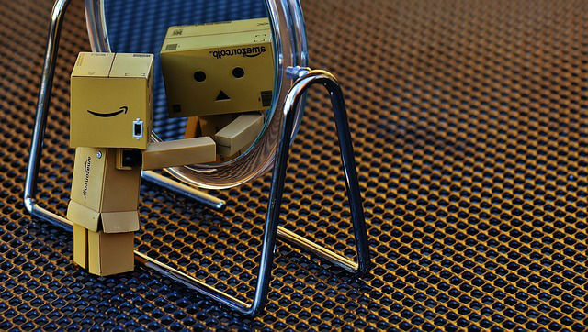
What we are seeing in a mirror is a virtual image.
The virtual image will be flipped horizontally - this is why writing is always backward in a mirror.
The object appears to be on the other side of the mirror, but it is simply a false image created by light reflecting from the mirror into your eyes.

Slide 14
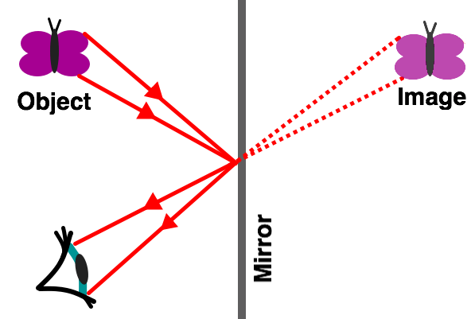
We see virtual images because our eyes are designed to recieve images that have travelled in a straight line from an object to you.
So when reflected light reaches us, our brains trace that light back through the mirror to where we think the object should be.
You can see this in the diagram below:

Slide 15
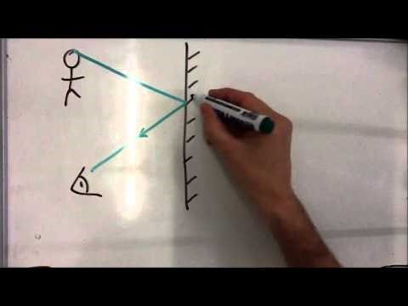

Slide 16
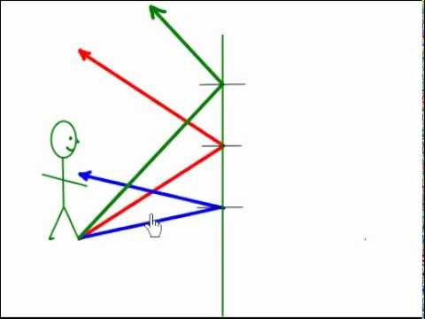

Slide 17
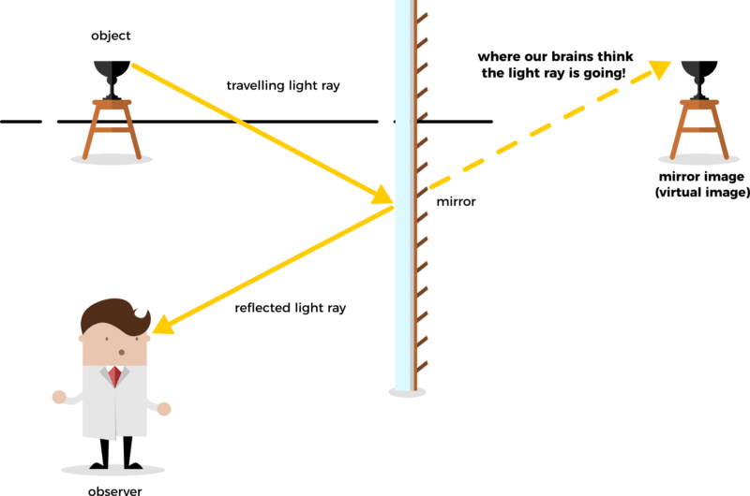
There are a few other important things that you need to know about images formed in plane mirrors.
These images are always the same size as the object is. This means that it is not magnified.
The distance from the image to the mirror is the same as the distance from the object to the mirror.

Slide 18
The images formed in plane mirrors are upright.
It is also reversed sideways. This means that left and right are flipped over. This is called lateral inversion.

